Slide 1
PHISHING AWARENESS TRAINING
PRESENTATION BY RICHARD KUSI
CA/AG1/30978
2nd August,2024

Slide 2
outline
Recognizing Phishing Emails
Recognizing Phishing Websites
Social Engineering Tactics
Common Social Engineering Techniques
Best Practices To Avoid Phishing Attacks
Case Study
Conclusion
References
Questions And Answers

Slide 3
Recognizing and Avoiding Phishing Attacks
Objectives
Understand what phishing is and its various forms.
Recognize common signs of phishing emails and websites.
Learn about social engineering tactics used in phishing.
Implement best practices to avoid Phishing attacks.

Slide 4
Introduction to Phishing
What is Phishing?
Phishing is a type of cyber attack, whereby an attacker makes a fraudulent attempt to obtain sensitive information by disguising as a trustworthy entity. These attacks are often conducted through emails,websites, and other communication channels.

Slide 5
Types of Phishing Attacks
Email Phishing: Fraudulent emails that appear to be from legitimate sources.
Spear Phishing: Targeted phishing attacks directed at specific individuals or organizations.
Whaling: Phishing attacks aimed at senior executives and other high-profile targets.
Smishing: Phishing attacks conducted via SMS messages.
Vishing: Phishing attacks conducted via voice calls.

Slide 6
Recognizing Phishing Emails
Red Flags in Phishing Emails...
Generic greetings (e.g., 'Dear Customer').
Suspicious sender email addresses.
Urgent or threatening language.
Unusual requests for personal information.
Unusual attachments or links.

Slide 7
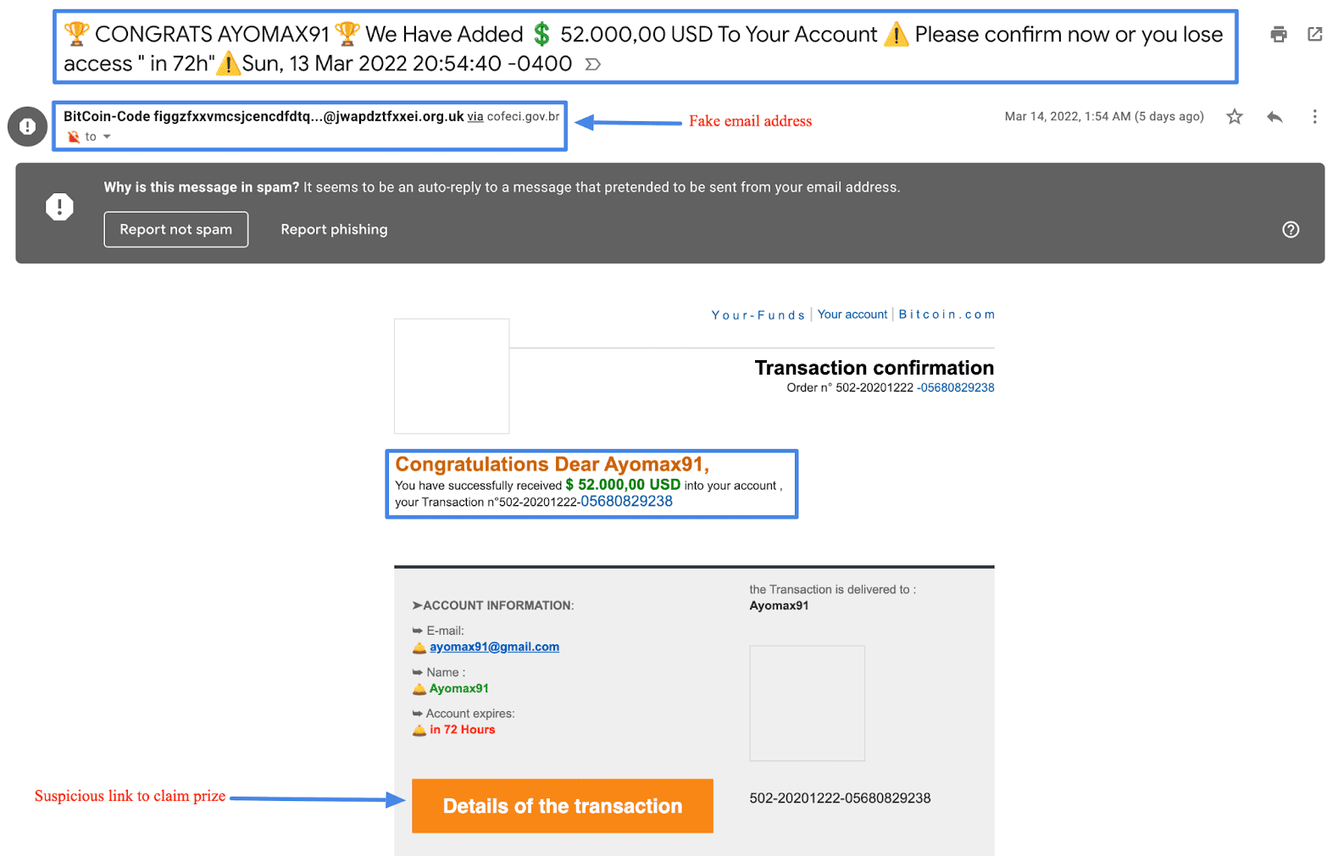
Example of a phishing email

Slide 8
Recognizing Phishing Websites
Identifying Fake Websites:
Check the URL for slight misspellings or unusual domains.
Look for HTTPS and a padlock icon.
Be wary of pop-ups asking for personal information.
Check for poor design or language errors.

Slide 9
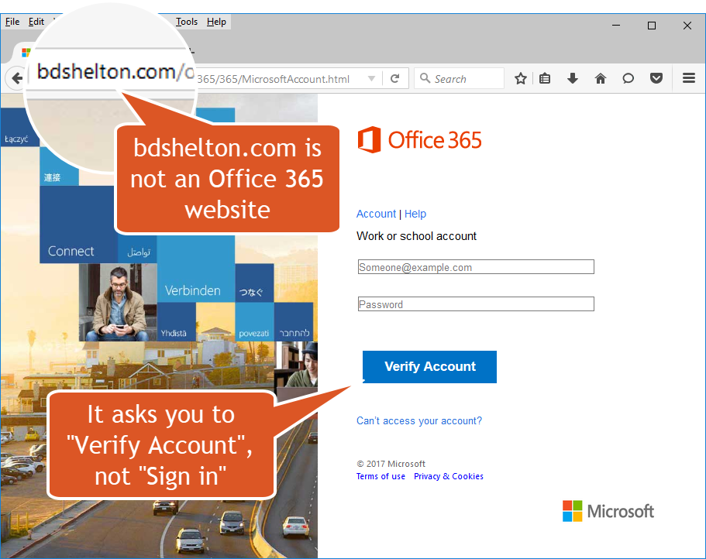
Example of a Phishing website...

Slide 10
Social Engineering Tactics
What Is Social Engineering?
Social engineering is the psychological manipulation of individuals into performing actions or divulging confidential information. Phishing is a common social engineering tactic used to trick people. A common example is Phishing.

Slide 11
Common Social Engineering Techniques
Pretexting: Creating a fabricated scenario or lying to steal personal information.
Baiting: Offering something enticing to get personal information.
Quid Pro Quo: Offering a service in exchange for information.
Tailgating: Following someone into a restricted area to gain access.

Slide 12
Best Practices to Avoid Phishing Attacks
Email Security Tips
Always verify the sender's email address.
Question the authenticity of unexpected emails.
Avoid clicking on links in unsolicited emails.
Enable MFA for an extra layer of security.
Web Security Tips
Always check the URL before entering sensitive information.
Use bookmarks for frequently visited websites to avoid typing errors.
Use reputable security software to detect and block phishing websites.
CONT’D.....

Slide 13
Best Practices to Avoid Phishing Attacks
General Security Tips
1. Stay informed about the latest phishing tactics.
2. Report suspicious emails and websites to your IT department or relevant authority.
3.Keep your software and systems updated to protect against vulnerabilities.
CONT’D.....

Slide 14
Case Study
Real-life Example Of A Phishing Attack:
Target Data Breach (2013)
In 2013, cybercriminals used a phishing email to gain access to Target's network through a third-party vendor. The attackers installed malware on Target's point-of-sale systems, compromising the credit and debit card information of approximately 40 million customers and personal information of about 70 million more.
Impact
Organization: $18.5 million in settlements, reputational damage, and enhanced security costs.
Individuals: 40 million card details and 70 million personal records compromised.

Slide 15
CASE STUDY
Lessons Learned and Preventative Measures
Improved network segmentation and monitoring.
Tighter access controls for third-party vendors.
Better cybersecurity training to recognize phishing.
Continuous security assessments.
CONT’D...

Slide 16
Conclusion
Phishing attacks are a significant threat, but by staying vigilant and following best practices, you can protect yourself and your organization. Always be cautious, verify suspicious communications, and report any phishing attempts to help keep everyone safe.
Key Takeaways:
Always be vigilant and skeptical of unexpected communications.
Educate yourself and others on recognizing phishing attempts.
Implement security measures to protect against phishing attacks.

Slide 17
RESOURCES
https://images.app.goo.gl/PhRNqaVC3kKhjQsQ9
https://youtu.be/zflsg6TRuos?si=nJn1dQmFQchHNvWo
https://www.msvu.ca/campus-life/campus-services/it-services/it-security/phishing/phishing-login-form-examples/
https://images.app.goo.gl/PhRNqaVC3kKhjQsQ9

Slide 18
Questions and Answers

